Slide 1
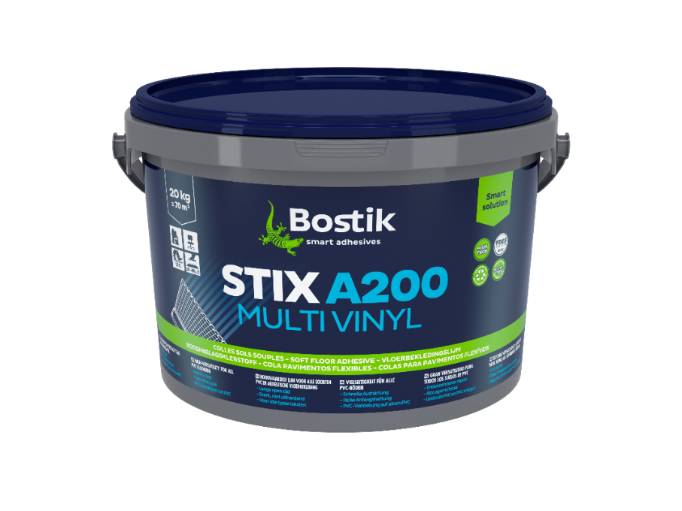
STIX A200 MULTI VINYL
Multi-purpose adhesive for all vinyl coverings
 |  | *from date of manufacture in original, unopened packaging, clear of the ground, in cool, dry conditions within the temperature range +5°C to +25°C and out of direct sunlight. Protect from frost, damp, condensation and dew. **these times are determined at + 23° C and 50 % relative humidity on normally absorbent substrates
Rapid curing High initial grab PVC bonding on old PVC
DESCRIPTION STIX A200 MULTI VINYL is a multi-purpose acrylic adhesive for laying soft floor covering: homogeneous and heterogeneous PVC, carpet with any type of backing, and natural fibres. DESTINATION It’s a universal multi-purpose adhesive suitable for the installation of most soft floor coverings. For all types of resilient flooring in residential and commercial projects. Also suitable for shower units with PVC floors and walls Recommended by most of the manufacturers For interior use only. Associated floor coverings : Homogeneous and heterogeneous PVC sheeting and tiles Cork with PVC backing Expanded vinyl Semi-flexible tiles Textiles: needle punch with or without backing, foam Non-woven textile floor coverings Natural fiber floor coverings (Coir, sisal and sea grass).
KEY BENEFITS
APPLICATIONS
PRODUCT CHARACTERISTICS
Colour | Cream
Composition | Acrylic water based
Storage / Shelf life* | 12 months
Application temperature | 10°C to 30°C
Waiting time** | 10-15min
Open time** | 45-50min
Walk on time** | 12 hours
Curing time* | 24 to 48 hours
Coverage | 250-400 g/m²

Slide 2
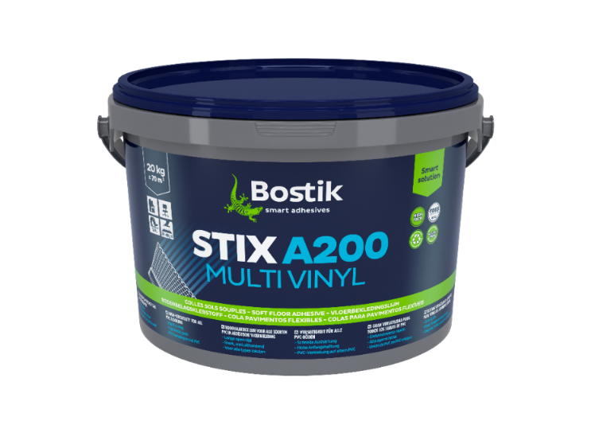
 |  | Bond the floor covering by applying a rubbing block and/or roller to expel trapped air and ensure good transfer of the adhesive. Repeat after 30 minutes to expel trapped air and ensure good contact. Do not weld the joints before the adhesive has had sufficient time to develop a good bond (approx. 24 to 48 hours after installation). From 250 to 400 g/m² depending on the type of coating and the spatula used. Up to 12 months in the original unopened container stored between +10°C and +30°C. Frost-sensitive Clean tools and equipment with warm water immediately after use. Remove any adhesive from the surface of the floor covering with a damp cloth.
PREPARATION Subfloor: Ensure the subfloor is in accordance with building standards. Subfloors must be clean, sound, dry (<75%RH), and free from contaminants that may impair adhesion e.g. dust, grease, paint, plaster, polish, water softenable adhesive etc. For subfloors that are not sufficiently smooth or require height build up to receive the particular floor covering being bonded, an application of a suitable Bostik self-levelling compound and primer system is recommended. Please consult Technical Services for advice on specific products and subfloors. Very absorbent subfloors such as open textured screeds and plywood should be primed prior to applying adhesive, with a suitable Bostik primer. Priming reduces over-absorption of the adhesive into the substrate, giving a good working time and strong adhesive bond. Before applying any adhesive, ensure the substrate is dry and dust free. Underfloor heating systems: Underfloor heating systems must be switched off for 48 hours before installation. Wait 7 days after installation before gradually turning up underfloor heating. APPLICATION Select appropriate trowel size and application method for the floor covering and apply the adhesive evenly onto the subfloor, holding the trowel at an angle of 60°. Leave the adhesive for the appropriate open time. To minimise the effect of adhesive serrations showing through thin floor coverings, pre-wet a roller with adhesive and flatten what has been applied to the subfloor. DRYING TIME The 10-15 minutes waiting time must be respected to minimize the risk of puddle formation (except for linoleum). Lay the floor covering while the adhesive remains tacky and receptive.
DIRECTIONS FOR USE
COVERAGE
STORAGE STABILITY
CLEANING
Code | UC | PCB | PALLET. | GENCOD
30615675 | 6 kg | 1 | 80 | 3549212484828
30615552 | 20 kg | 1 | 32 | 3549212484804
FLOOR COVERING | TROWEL SIZE | CONSUMPTION
Coverings with a smooth backing (PVC tiles and strips, E.V.R., foams) | A2 | 0.2kg - 0.25kg/m²
Thin coverings to avoid glue streaks during use | short wool roller (such as a lacquer roller) | Roll with a short wool roller and then lay on the wet adhesive film
Coverings with a textured backing | B1 | 0.3kg - 0.35kg/m²
Coverings with a high relief on the reverse side (e.g. coir with latex backing) | B2 | 0.4kg - 0.45kg/m²
SAFETY
For more details, consult the safety data sheet on https://bostiksds.thewercs.com/default.aspx
The information given and recommendations made herein are based on Bostik’s research only and are not guaranteed to be accurate. The performance of the product, its shelf life, and application characteristics will depend on many variables, including the kind of materials to which the product will be applied, the environment in which the product is stored or applied, and the equipment used for application. Any change in any of these variables can affect the product’s performance. It is the buyer’s obligation, prior to using the product, to test the suitability of the product for an intended use under the conditions that will exist at the time of the intended use. Bostik does not warrant the product’s suitability for any particular application. The product is sold pursuant to Bostik’s Terms and Conditions of Sale that accompanies the product at the time of sale. Nothing contained herein shall be construed to imply the nonexistence of any relevant patents or to constitute permission, inducement, or recommendation to practice any invention covered by any patent, without authority from the owner of the pat
BOSTIK TECHNICAL ASSISTANCE
Smart Help +XX XX XXX XXX

